Slide 1
Efficient, Effective Interactive Visualizations
eugene wu
Columbia University

Slide 2
This presentation contains some animation.
See the animation in the powerpoint file at:
https://cudbg.github.io/sigmod19tutorial//files/wu.pptx

Slide 3
More Great Tutorials/Workshops!
Evaluating Interactive Data Systems: Workloads, Metrics, & Guidelines.
SIGMOD18. Jiang, Rahman, Nandi
Overview of Data Exploration Techniques.
SIGMOD15. Idreos, Papaemmanouil, Chaudhuri
HILDA: Human in the Loop Data Analysis
SIGMOD Workshop. http://hilda.io
DSIA: Data Systems for Interactive Analysis
VIS Workshop. https://www.interactive-analysis.org
Connecting Visualization and Data Management Research
Dagstuhl Workshop. Chang, Fekete, Freire, Scheidegger.

Slide 4
Road Map
Background
Mechanisms
A Relational Story

Slide 5
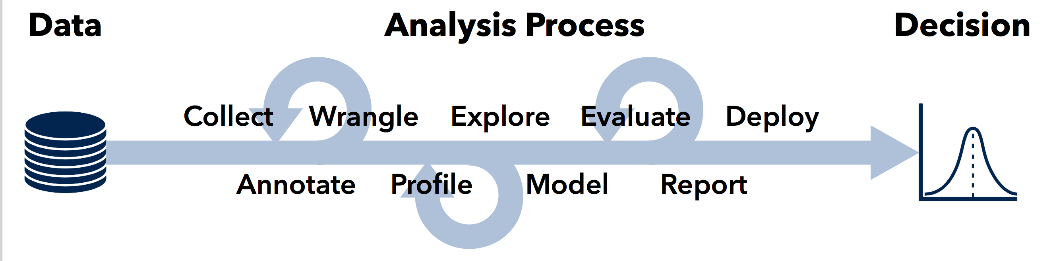
Visualization is Ubiquitous
Image: Visualization is Not Enough - Heer EuroVIS19

Slide 6
accessibility
performance
usability
expressiveness
...
Human Data Interface
Data
Remove computing bottleneck
Tutorial: focus on performance

Slide 7



SVD architecture SQL,Vis,DB
ECMAScript VM
Client-side vis libraries very robust
Borrows data flow, event processing, incremental updates from databases.
Outputs scene graph
Great for small datasets

Slide 8
SVD architecture SQL,Vis,DB
ECMAScript VM
Client-side vis libraries very robust
Borrows data flow, event processing, incremental updates from databases.
Outputs scene graph
Great for small datasets
Bigger dataset? Much messier!
Communication overheads
DBs slower
Queries slower
network
App Server
Database

Slide 9
SVD architecture SQL,Vis,DB
ECMAScript VM
Client-side vis libraries very robust
Borrows data flow, event processing, incremental updates from databases.
Outputs scene graph
Great for small datasets
Bigger dataset? Much messier!
Communication overheads
DBs slower
Queries slower
Caches everywhere
Smart caches (DBs) everywhere
Cache
DB
network
App Server
Database

Slide 10
SVD architecture SQL,Vis,DB
ECMAScript VM
Latency is cumulative
Separate components/code lines
Manual implementation
Manual optimization
Akin to writing queries
before Rel Alg.
Cache
DB
network
App Server
Database

Slide 11
Vis Memory Hierarchy
ECMAScript
Absolute latency expectations
Complex analysis workloads
Data dense
Analysis (usually) already known
Local Machine
network
Big Server
Big Database

Slide 12
The Bottom Line
ECMAScript VM
Simple programming API for
interactive applications over
large-scale/in-DB data is
unsolved
→
Massive opportunity
Cache/DB
network
App Server
Database

Slide 13
Mechanisms that leverage vis semantics

Slide 14
Overview of Mechanisms
Semantics
Idea
Interaction
Scale cube dimensionality to interactions
Interaction
Network Pre-fetch as prediction
Render
Aggregate results to reduce network cost
Push rendering logic into query processing
Perception
Approximation
Push perceptual inaccuracies into query processing
Task
Know the Task
Ensure Vis API provides rich optimization hints

Slide 15
Overview of Mechanisms
Semantics
Idea
Interaction
Scale cube dimensionality to interactions
Interaction
Network Pre-fetch as prediction
Render
Aggregate results to reduce network cost
Push rendering logic into query processing
Perception
Approximation
Push perceptual inaccuracies into query processing
Task
Know the Task
Ensure Vis API provides rich optimization hints

Slide 16
Cubes: Immens
C
B
a1
a2
a3
b1
b2
b3
c1
c2
c3
A
data cube
Cross filtering
interact with data in A, filter data in B
Build data cube

Slide 17
Cubes: Immens
C
B
a1
a2
a3
b1
b2
b3
c1
c2
c3
A
data cube
Cross filtering
interact with data in A, filter data in B
Build data cube

Slide 18
Cubes: Immens
C
B
a1
a2
a3
b1
b2
b3
c1
c2
c3
A
data cube
Cross filtering
interact with data in A, filter data in B
Build data cube

Slide 19
Cubes: Immens
Airlines
States
Departure
Delay
Years
Day
Months
6D CUBE
50 * 21 * 12 * 23 * 9 * 7000 > 18B ints ~ 144GB
Idea: User doesn’t express all combinations

Slide 20
Cubes: Immens
SELECT airline, COUNT
Airlines
Departure Delay
SELECT delay, COUNT

Slide 21
Cubes: Immens
1D
SELECT airline, COUNT
WHERE delay = 4
Airlines
1D
Departure Delay
SELECT delay, COUNT
Interaction is 2D:
CUBE on airline, delay
Build cube for pairs of plots
K 1D plots, N values per attr
Naïve: N^{K} ~18,000,000,000
Immens: N²K² 809,765

Slide 22
Cubes
Takeaway
Scale to dimensionality of vis interactions
data is high dim
interactions can be low dim
Refs: nanocubes (Lins. TVCG13); hashedcubes (Pahins. InfoVIS16); Falcon (Moritz. CHI19)

Slide 23
Overview of Mechanisms
Semantics
Idea
Interaction
Scale cube dimensionality to interactions
Interaction
Network Pre-fetch as prediction
Render
Aggregate results to reduce network cost
Push rendering logic into query processing
Perception
Approximation
Push perceptual inaccuracies into query processing
Task
Know the Task
Ensure Vis API provides rich optimization hints

Slide 24


Network: ForeCache
Middleware
easier to deploy
middleware has more resources
Middleware sees inputs
Client requests (pan/zoom)
Data content
Middleware does actions
make (good) predictions
pre-fetch tiles/requests
Local viewport
ForeCache
middleware
Prefetcher
Massive tiled dataset
NASA World View
Dynamic Prefetching of Data Tiles for Interactive Visualization. Battle et al.

Slide 25
Network: ForeCache
Middleware
easier to deploy
middleware has more resources
Middleware sees inputs
Client requests (pan/zoom)
Data content
Middleware does actions
make (good) predictions
pre-fetch tiles/requests
Local viewport
ForeCache
middleware
Prefetcher
Massive tiled dataset
NASA World View
Dynamic Prefetching of Data Tiles for Interactive Visualization. Battle et al.

Slide 26
Network: ForeCache
Predict 1 of k actions
P(action | state)
Actions:
Pan ← ↑ → ↓ ↖ ↗ ↘ ↙
Zoom
Extend State using:
Behavior features
Overview, Zoom, Details on Demand
Map tile content features
Local viewport
ForeCache
middleware
Prefetcher
Massive tiled dataset
NASA World View
Dynamic Prefetching of Data Tiles for Interactive Visualization. Battle et al.

Slide 27
Network: Other Examples
Predict 1 of k actions
P(action | state)
Restrict Actions
Semantic windows, ATLAS, SCOUT
← →
↑ ↓
Local viewport
ForeCache
middleware
Prefetcher
Massive tiled dataset
NASA World View

Slide 28
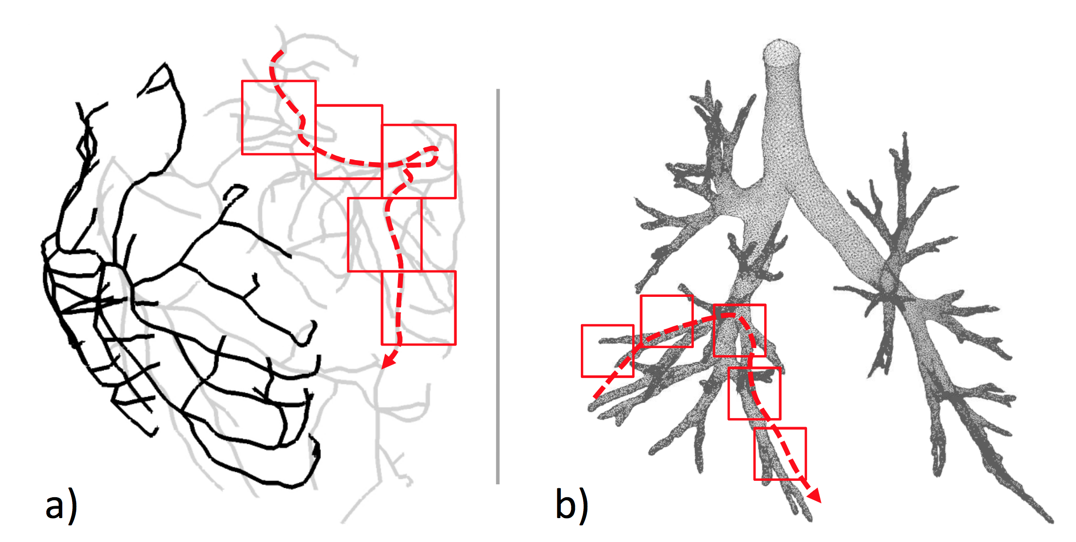
Network: Other Examples
Predict 1 of k actions
P(action | state)
Apply Domain Structure
SCOUT: graph edges instead of arbitrary 3D navigation. Prefetch from disk
DICE, Query Steering: OLAP/Markov assumptions
Local viewport
ForeCache
middleware
Prefetcher
Massive tiled dataset
NASA World View

Slide 29
Network
Takeaway
Pre-fetch relies on prediction
improve predictor w/
interaction + content
Refs: Falcon (Moritz. CHI19); Momentum/Hotspot (Doshi. Thesis); ATLAS (Chan. VAST08); DICE (Kamat. ICDE14); Semantic Windows (Kalinin. SIGMOD14); Scout (Tauheed. VLDB12)

Slide 30
Overview of Mechanisms
Semantics
Idea
Interaction
Scale cube dimensionality to interactions
Interaction
Network Pre-fetch as prediction
Render
Aggregate results to reduce network cost
Push rendering logic into query processing
Perception
Approximation
Push perceptual inaccuracies into query processing
Task
Know the Task
Ensure Vis API provides rich optimization hints

Slide 31
Network: M4
Prefetching trades
bandwidth for latency
What if bandwidth limited?
Prefetch makes things worse
Vis System
High throughput
Low throughput
Network
Database
High throughput
M4: A Visualization-Oriented Time Series Data Aggregation. Jugel et al.

Slide 32

Network: M4
Low Resolution
res = Q(database) // on DB
vis = render(res) // on client
Vis System
High throughput
Network is bottleneck
Query results can be massive
Idea
vis resolution << result size
Low throughput
Network
Database
High throughput
kills the network
M4: A Visualization-Oriented Time Series Data Aggregation. Jugel et al.

Slide 33
Network: M4
Low Resolution
res’ = M4_Q(database) // on DB
vis = render(res’) // on client
Vis System
High throughput
Network is bottleneck
Query results can be massive
Idea
vis resolution ~ M4(results)
Low throughput
Network
Database
High throughput
M4: A Visualization-Oriented Time Series Data Aggregation. Jugel et al.

Slide 34
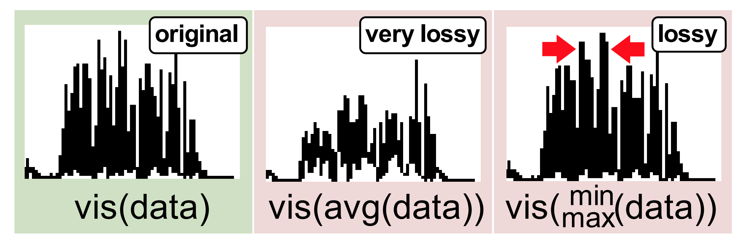
Network: M4
Low Resolution
Each pixel has many data values.
Aggregate by pixel? How?
Account for rasterization & antialiasing
Vis System
High throughput
min
max
vis(data)
vis( (data))
M4(data)
Low throughput
M4
Network
Database
High throughput
M4: A Visualization-Oriented Time Series Data Aggregation. Jugel et al.

Slide 35
Network
Takeaway
Rendering Push-down
open rendering black-box &
push into database

Slide 36
Overview of Mechanisms
Semantics
Idea
Interaction
Scale cube dimensionality to interactions
Interaction
Network Pre-fetch as prediction
Render
Aggregate results to reduce network cost
Push rendering logic into query processing
Perception
Progressive Vis and Approximation
Push perceptual inaccuracies into query processing
Task
Know the Task
Ensure Vis API provides rich optimization hints

Slide 37
Progressive Visualization
Visualization quality improves over time
Many forms of Progressive, such as...
Queries Data sampling
Rendering Result Encoding
Interaction granularity Interaction Design
quality
time

Slide 38
Progressive Queries
Quality ~ error bounds for Q(D)
Online Aggregation (Hellerstein SIGMOD97)
Wander Join (Li SIGMOD16)
Iterative sampling w/ perceptual models (P-funk Abali15)
Time

Slide 39
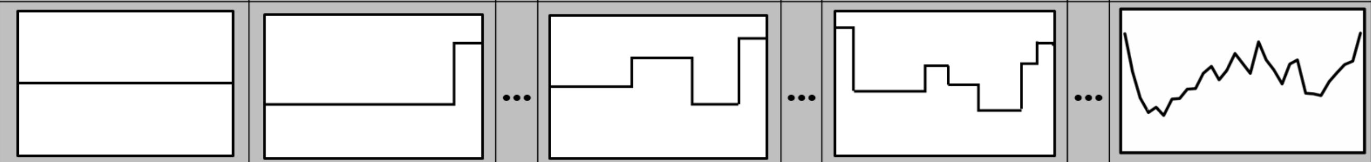
Progressive Communication
Quality ~ E[difference from full resolution]
Progressive image encoding (JPEG)
Speak summary, then fill in details (CiceroDB Trummer19)
Incrementally sample at higher resolutions (IncVisage Rahman17)
Time

Slide 40
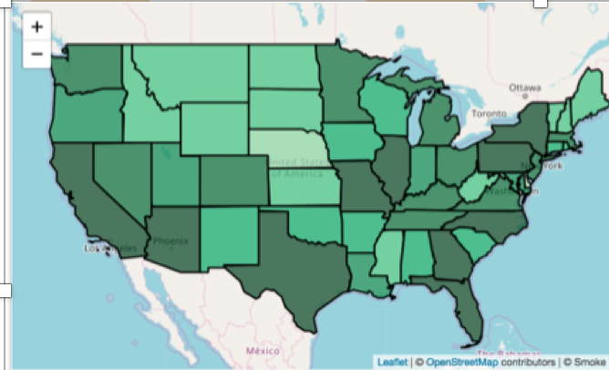
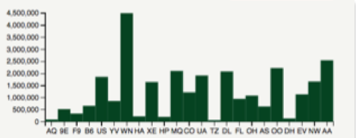
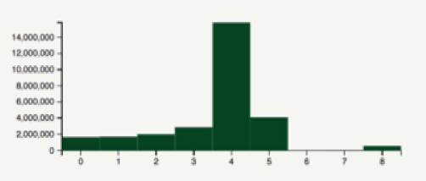
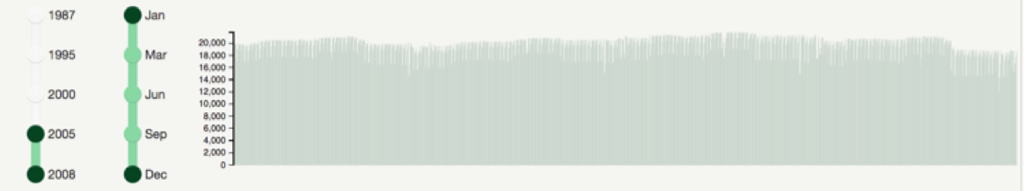
Progressive Loading
Quality ~ How much of the vis is shown
Number of charts loaded in dashboard
Webpage loading “above the fold” (Polaris netravali16)
Time

Slide 41
Progressive Interactions
Quality ~ Interaction granularity
Request throttling
Higher brushing resolution over time (Falcon Moritz19)
Number of ticks in slider increase over time
Time

Slide 42
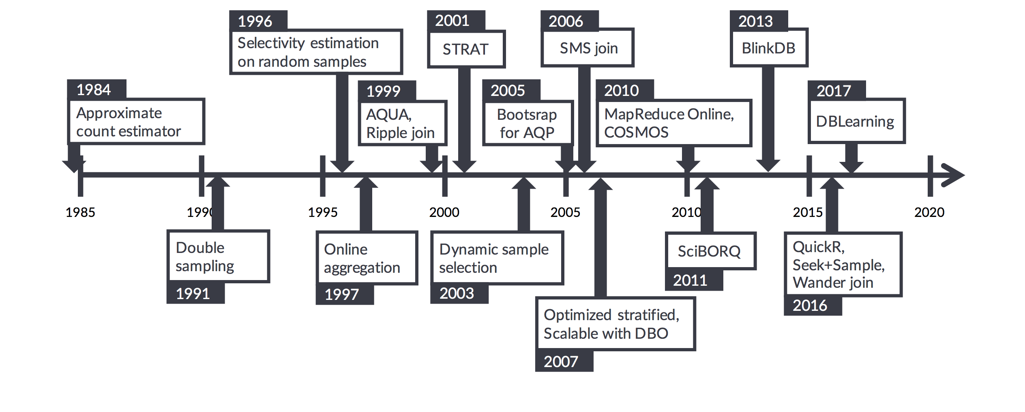
Approximate Query Processing
Progressive query processing and AQP are long-standing problems in databases
Adapting AQP to visualization also depends on
visualization semantics
from https://yongjoopark.com/resources/verdictdb_sigmod18.pdf

Slide 43
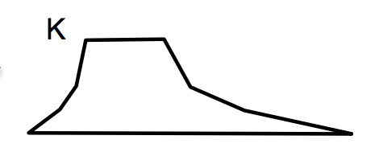
Approximate Query Processing
lossy
Offline Sampler
(workload)
lossy
Vis System
approx ops
samplers
Query time
Offline

Slide 44
Query Time Approximation
Offline:
Do nothing
When running Q:
Choose sample operators
Draw samples to answer Q
approx ops
samplers
Query time
Approximate Query Processing: No Silver Bullet – Chaudhuri et al

Slide 45
Query Time: WanderJoin
A⋈B⋈C
WanderJoin: leverage join indexes
edges represent join matches
Sample from A. Then path from A to C (a2-b2-c1) is a join sample
random walk is non-uniform independent sample
A
B
C
id
id
id
a1
b1
c1
a2
b2
c2
a3
b3
c3
a4
b4
c4
a5
b5
c5
Wander Join: Online Aggregation via Random Walks – Li et al SIGMOD16

Slide 46
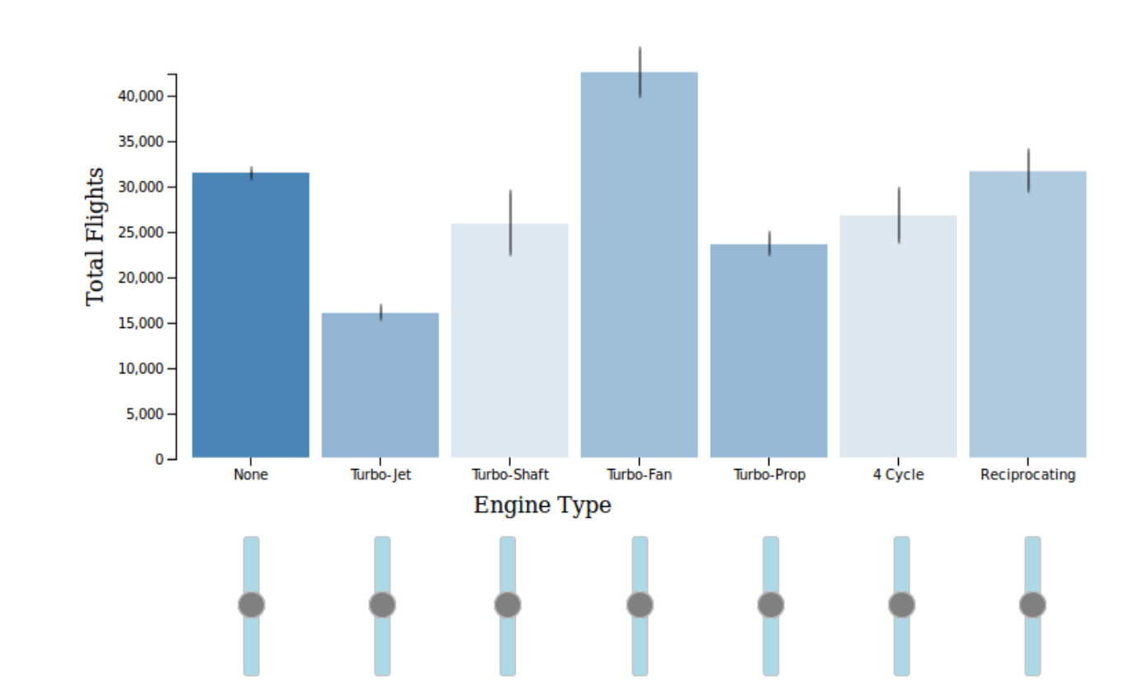
Query Time: WanderJoin
A⋈B⋈C
Vis is dominated by filtering and group-bys (filter by group)
Adapt WJ by biasing random walk via importance sampling for..
Filters and dynamic selections
User preferences
A
B
C
id
id
id
a1
b1
c1
a2
b2
c2
a3
b3
c3
a4
b4
c4
a5
b5
c5
Selective Wander Join: Fast Progressive Visualizations for Data Joins – Procopio et al

Slide 47
Query Time Approximation
Offline:
Do nothing
When running Q:
Choose sample operators
Draw samples to answer Q
Sampling is expensive
WanderJoin uses join indexes.
Could use indexing time to build other data structs?
Can take long time for bounds to be small
approx ops
samplers
Query time
Approximate Query Processing: No Silver Bullet – Chaudhuri et al

Slide 48
Offline
Offline:
Precompute samples given workload W
Typically stratify on columns groups in W
When running Q:
Pick precomputed samples
Use CLT/Hoeffding/bootstrap for err bounds
Offline Sampler
(workload)
Offline
Approximate Query Processing: No Silver Bullet – Chaudhuri et al

Slide 49
Offline: Sample+Seek
Adapts AQP towards visualization needs in 2 ways.
Challenges with confidence intervals (CIs)
CI ~ std(n samples) / sqrt(n)
CIs unintuitive
data dependent → sensitive to outliers
90th CIs
Useful?
¯\_(ツ)_/¯
Sample + Seek: Approximating Aggregates with Distribution Precision Guarantee

Slide 50
Offline: Sample+Seek
Proposes Distributional Guarantee
Result modeled as normalized distribution
Offline pre-computation will bound L₂ distance ≤ ɛ
Closer to understandable semantics
|truth - estimated|₂ ≤ ɛ
Sample + Seek: Approximating Aggregates with Distribution Precision Guarantee

Slide 51
Offline: Sample+Seek
Don’t stratify by column groups
Column groups may be different later on
Compute measure-biased samples for aggregated attrs
Need to know aggregated measures up front
SELECT a1, a2, ..., SUM(v1), COUNT(v2)
FROM ...
GROUP BY a1, a2, ...
Sample + Seek: Approximating Aggregates with Distribution Precision Guarantee

Slide 52
Offline: Sample+Seek
Measure-biased samples for SUM(val): proportional to val
100 rows
val
1
..
1
100
p_{naive}
1/100
..
1/100
1/100
p_{s+s}
1/199
..
1/199
100/199
If we sample 1 val (100), what is our estimate?
100/(1/100)
= 10,000
100/(100/199)
= 199
Addresses err bound’s Data Dependency
Sample + Seek: Approximating Aggregates with Distribution Precision Guarantee

Slide 53
Offline: Sample+Seek
Sample probability based on value
result = Q(in-memory sample)
if enough samples in mem:
return result
if very low selectivity:
lookup rows directly
else:
use measure-augmented index to
draw sample biased by b
Q = SELECT a, SUM(b)
WHERE c=1 ...
GROUPBY b
In-mem
Samples
On-disk Indexes
Sample + Seek: Approximating Aggregates with Distribution Precision Guarantee

Slide 54
Offline
Offline:
Precompute samples given workload W
Stratify on columns groups in W
When running Q:
Pick precomputed samples
Use CLT/Hoeffding/bootstrap for err bounds
Hard to guarantee bounds are small if Q uses unseen col group
Measure-biased sampling helps, works if aggregation function is over sampled attributes!
Offline Sampler
(workload)
Offline
Approximate Query Processing: No Silver Bullet – Chaudhuri et al

Slide 55
What is Quality?
SELECT avg(sales)
GROUP BY month
ERROR 0.1 CONF 99%
Confidence interval per record
Error 0.1 Conf 99%
Jan
Feb
Mar
Stepping back, a bigger question is what quality should mean! Tricky even for classic error specifications in AQP

Slide 56
What is Quality?
SELECT avg(sales)
GROUP BY month
ERROR 0.1 CONF 99%
Perceived
error
Jan
Feb
Mar
true avg
A single error for a query may not be sufficient. Perceptual research says that the error bounds DEPENDS on the result values.
Wrong
Wasted Work
PFunk-H (Alabi HILDA16); At-a-Glance (Ryan InfoVIS18)

Slide 57
What is Quality?
SELECT avg(sales)
GROUP BY month
ERROR 0.1 CONF 99%
Confidence interval per record
Error 0.1 Conf 99%
Pairwise statistical test
Pairwise CI don’t overlap too much
Distributional guarantee
E[distance from true distribution]
Jan
Feb
Mar
CI isn’t even the only notion of quality to begin with!

Slide 58
What is Quality?
SELECT avg(sales)
GROUP BY month
ERROR 0.1 CONF 99%
Q: Who decides Quality?
Jan
Feb
Mar
A: Perception Science

Slide 59
The Human Side (a sample of works)
At a Glance: Approximate Entropy as a Measure of Line Chart Visualization Complexity
Ryan et al. InfoVIS19
The Human User in Progressive Visual Analytics
Micallef et al. EuroVIS (Dagstuhl report)
What Users Don't Expect about Exploratory Data Analysis on Approximate Query Processing Systems
Moritz et al. HILDA17
Why Evaluating Uncertainty Visualization is Error Prone
Jessica Hullman BELIV16

Slide 60
Approx + Progressive
Takeaway
Perception Push-down
Model perceptual inaccuracy &
push into database
Dagstuhl report on progressive visualization: http://drops.dagstuhl.de/opus/volltexte/2019/10346/

Slide 61
Overview of Mechanisms
Semantics
Idea
Interaction
Scale cube dimensionality to interactions
Interaction
Network Pre-fetch as prediction
Render
Aggregate results to reduce network cost
Push rendering logic into query processing
Perception
Approximation
Push perceptual inaccuracies into query processing
Task
Know the Task
Ensure Vis API provides rich optimization hints

Slide 62
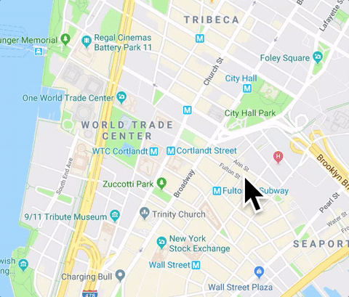
Tasks: Kyrix
Kyrix: visualization as map
Layers render rows (map tiles, pins)
User sees through viewport
Interaction = change bounding boxes
→Pan viewport to see more data
→Zoom/click to switch layers
Kyrix: Interactive Pan/Zoom Visualizations at Scale – Tao EuroVis19

Slide 63
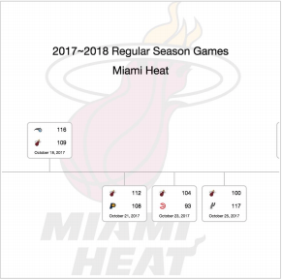


Tasks: Kyrix
Kyrix: visualization as map
Layers render rows (map tiles, pins)
User sees through viewport
Interaction = change bounding boxes
→Pan viewport to see more data
→Zoom/click to switch layers
Kyrix: Interactive Pan/Zoom Visualizations at Scale – Tao EuroVis19

Slide 64
Tasks: Kyrix
simplified pseudocode
logos = vis.canvas(w, h)
// xform1 computes logo positions
// be rendered in layer
logos.newlayer(xform1, render1)
Client
get(layer,
viewport)
layer data
Easy Developer API
rtree indexs
layers
xform1()
BigData
Kyrix: Interactive Pan/Zoom Visualizations at Scale – Tao EuroVis19

Slide 65
Tasks
Takeaway
Know the Task
Task-based Programming API
Leverage richer semantics

Slide 66
An End-to-end Relational Story
DVMS

Slide 67
Overview of Mechanisms
Semantics
Idea
Interaction
Scale cube dimensionality to interactions
Interaction
Network Pre-fetch as prediction
Render
Aggregate results to reduce network cost
Push rendering logic into query processing
Perception
Approximation
Push perceptual inaccuracies into query processing
Task
Know the Task
Ensure Vis API provides rich optimization hints

Slide 68
Many Disparate Optimizations
How to choose?
Developer tells the system
Special case the system
Do they compose?
Need to model application semantics
Hard for dev. API?
Limits Flexibility
How?

Slide 69
Data Visualization Management System
ECMAScript VM
Want to express visualization, interaction, tasks, perception all together
Vis and interaction as queries
Apply relational ideas end-to-end
to interactions
to consistency
to design
Cache/DB
network
App Server
Database

Slide 70
Data Visualization Management System
A Big “Query”
Want to express visualization, interaction, tasks, perception all together
Vis and interaction as queries
Apply relational ideas end-to-end
to interactions
to consistency
to design

Slide 71
Roadmap
A Big “Query”
Overview of Relational Perspective
Optimizations within relational framework
Interactions as logical expressions
Single-view interaction
Multi-view interactions

Slide 72
A Relational Perspective
pixels
pixels(x, y, rgba)
render marks (projection)
marks
marks(type, x, w, h, color)
analysis + transform queries
data
flights(origin, year, delay,...)

Slide 73
A Relational Perspective
Logical model:
pipeline as a big query
input data, marks, pixels as tables.
pixels
Table
Query
marks
Table
Query
data
Table

Slide 74
A Relational Perspective
network
Render on server & send images
pixels
Table
Cutting the query plan using the network already expresses many app architectures
Query
marks
Table
network
Ship query results to client
Query
data
Table
network
Ship dataset to client

Slide 75
Constraints:
Perceptual
CI bounds
Latency
pixels
Table
Constraints:
Rendering (M4)
Query
marks
Table
Several earlier push-down optimizations can now be expressed as constraints on the query output or intermediate results
Query
data
Table

Slide 76
Example: Single View Interactions
Using Kyrix as an example

Slide 77
SELECT x, y, img
FROM NBA_icons
WHERE x >= ? AND
x < ? AND
y >= ? AND
y < ?
Q₁
At its core, Kyrix can be expressed as parameterized filter queries!
Sufficient to infer RTree indexes and caching

Slide 78
SELECT x, y, img
FROM NBA_icons, viewport vp
WHERE x >= vp.minx AND
x < vp.maxx AND
y >= vp.miny AND
y < vp.maxy
Q₁
We can remove the “?”s by “relational-izing” the current viewport. This gives us freedom to redefine vp as a view
viewport(minx, maxx, miny, maxy)
user interaction as data
DIEL: Transparent Scaling for Interactive Visualization - Yifan Wu

Slide 79
SELECT x, y, img
FROM NBA_icons, last_vp vp
WHERE x >= vp.minx AND
x < vp.maxx AND
y >= vp.miny AND
y < vp.maxy
Q₁
last_vp = SELECT *
FROM viewport
ORDER BY tstamp DESC
LIMIT 1
viewport(minx, maxx, miny, maxy, t)
user interaction as data
DIEL: Transparent Scaling for Interactive Visualization - Yifan Wu

Slide 80
SELECT x, y, img
FROM NBA_icons, last_vp vp
WHERE x >= vp.minx AND
x < vp.maxx AND
y >= vp.miny AND
y < vp.maxy
Manipulating viewport view definition
enables historical replay, undo, ...
for free!
Q₁
last_vp = SELECT *
FROM viewport
ORDER BY tstamp DESC
LIMIT 1
viewport(minx, maxx, miny, maxy, t)
user interaction as data
DIEL: Transparent Scaling for Interactive Visualization - Yifan Wu

Slide 81
Another Benefit of Relationalizing
DIEL: Transparent Scaling for Interactive Visualization - Yifan Wu

Slide 82
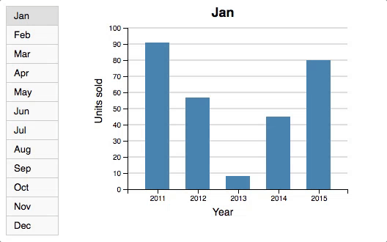
This slide contains animation. See powerpoint slides to see animation
Request
Response
But what if requests take time?
DIEL: Transparent Scaling for Interactive Visualization - Yifan Wu

Slide 83
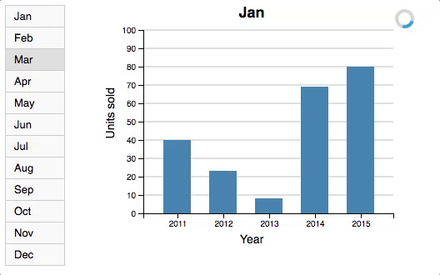
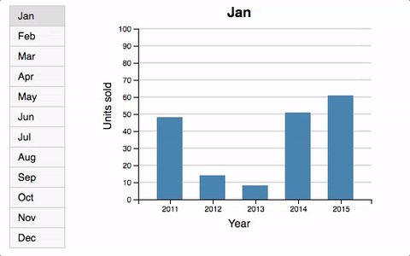
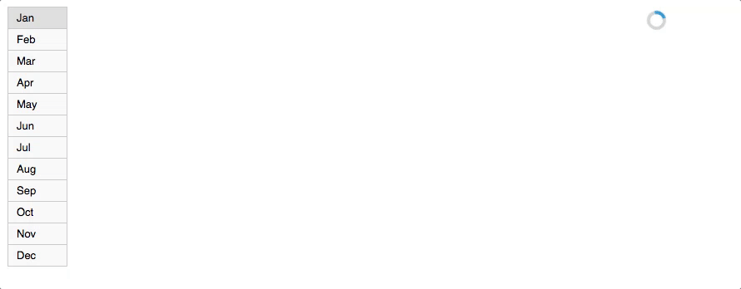
This slide contains animation. See powerpoint slides to see animation
No CC
Serial Order
All of these are sensible choices for a designer when dealing with latencies.
Historical Small Multiples
DIEL: Transparent Scaling for Interactive Visualization - Yifan Wu

Slide 84
Picking concurrency control
for interaction design is simple by
relationalizing user inputs & responses
No CC
Serial Order
All of these are sensible choices for a designer when dealing with latencies.
Historical Small Multiples
DIEL: Transparent Scaling for Interactive Visualization - Yifan Wu

Slide 85
Example: Multi-view Interactions
Q2 = SELECT x, f(y)
GROUP BY x
Q₁
Q₂
User selects bars in Q1’s chart...
Smoke: Fine-grained Lineage at Interactive Speeds. Psallidas19

Slide 86
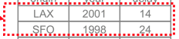
Example: Multi-view Interactions
Q2 = SELECT x, f(y)
WHERE id∈
GROUP BY x
Update Q2’s chart by adding the WHERE clause to Q2.
Many apps do this by manipulating SQL string literals to construct the query!
Q₁
Q₂
Smoke: Fine-grained Lineage at Interactive Speeds. Psallidas19

Slide 87

Q2 = SELECT x, f(y)
WHERE id∈
GROUP BY x
Q₁
Q₂
Syntactic manipulation rather than logical spec
Can do better?
Smoke: Fine-grained Lineage at Interactive Speeds. Psallidas19

Slide 88
Smoke: Interaction as Lineage
Backward Lineage
Q₁
Q₂
Selective View Refresh
Smoke: Fine-grained Lineage at Interactive Speeds. Psallidas19

Slide 89
Smoke: Interaction as Lineage
Builds lineage indexes while
running Q₁ and Q₂
w/ low overhead
Q₁
Q₂
Smoke: Fine-grained Lineage at Interactive Speeds. Psallidas19

Slide 90
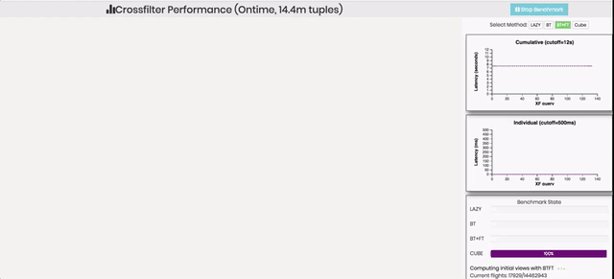
Smoke: Interaction as Lineage
This slide contains animation. See powerpoint slides to see animation
Lineage enables <100ms interactivity
Avoids data cube precomputation (mins or hrs)
Smoke: Fine-grained Lineage at Interactive Speeds. Psallidas19

Slide 91
Smoke: Interaction as Lineage
Lineage enables <100ms interactivity
Avoids data cube precomputation (mins or hrs)
Benefits
Any visualization expressible as lineage
(most coordinated visualizations)
can be optimized automatically
Smoke: Fine-grained Lineage at Interactive Speeds. Psallidas19

Slide 92
⨝
refresh(backward( ))
Backward Lineage
Q₁
Q₂
Selective View Refresh
Smoke: Fine-grained Lineage at Interactive Speeds. Psallidas19

Slide 93
⨝
Constraints:
Perceptual
CI bounds
Latency
refresh(backward( ))
Constraints:
Rendering (M4)
Backward Lineage
Q₁
Q₂
Selective View Refresh
viewport(minx, maxx, miny, maxy)
Smoke: Fine-grained Lineage at Interactive Speeds. Psallidas19

Slide 94
interaction(vis(database))
Constraints
Lineage( )
SQL
SQL( )

Slide 95
Stepping Back
Hacking entire SVD stack is hard
Programming API is important
Users often have existing data, analyses, designs
Wins are from moving up in semantics
Data flow mechanisms for execution
Higher level semantics for optimization
End-to-end relational approach needs to draw from...
Hierarchical models (for layout, subgraphs, etc)
Second order logic (changing group-by attrs)
Ordered relations (most vis is ordered)
...

Slide 96
Open Problem
Algebra to compose
data + interaction + design + task

Slide 97
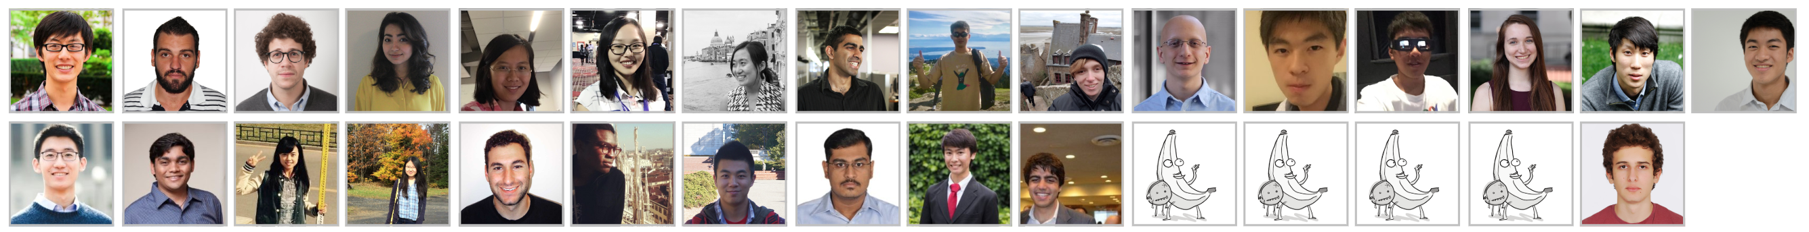

Conclusion
DVMS
eugenewu.net

